Slide 1
Distribution System Protection
ECpE Department
Dr. Zhaoyu Wang
1113 Coover Hall, Ames, IA
wzy@iastate.edu

Slide 2
Distribution System Protection
Acknowledgement:
The slides are developed based in part on Electric Power and Energy Distribution Systems, Models, Methods and Applications, Subrahmanyan S. Venkata, Anil Pahwa, IEEE Press & Wiley, 2022
ECpE Department

Slide 3
1. Overview and Philosophy
The famous protection engineer Mason wisely mentioned in his classic book [1] that power system protection is more an “art” than a “science.” It is one of the most complex and difficult topics in power system engineering. Though scientific principles provide the needed guidance to design a proper protection system, one can only master it through practical experience and through the lessons learned.
The first step is to learn the basic principles and understand them thoroughly. To protect the same system, each protection engineer could arrive at a different solution than his/her counterparts, and all could be valid solutions. This is unlike other topics such as power flow studies covered in Chapter 4 for which only unique solutions exist.

Slide 4
1. Overview and Philosophy
The primary philosophy of protection is to preserve sensitivity, selectivity, minimum time of operation, and reliability. It is a local protection philosophy covering about two to three buses (or nodes of all phases) beyond any protective device. Though dependable and robust, this philosophy does not cover a wider area for defense against catastrophic failures to provide higher reliability and resiliency. Quite often, these considerations could be conflicting, and protection engineers must make adequate compromise and trade-off to achieve proper protection of a distribution system with cost-effectiveness.

Slide 5
1. Overview and Philosophy
Safety of personnel and equipment is the paramount consideration of power system protection. The National Electric Reliability Council (NERC) has reported that 70% of outages in electric power systems are due to protection-related issues.
Distribution systems need protection against overcurrent and overvoltage. In this chapter, protection will be limited to overcurrent considerations only. Normally, overvoltage protection against electromagnetic transients is covered in separate courses.

Slide 6
1. Overview and Philosophy
During the past 25 years, distribution systems have experienced unprecedented transformation under the “Smart Grid” rubric with the infusion of innovative technologies in every automation domain: sensors, generation, control, communications, and computing. With the introduction of computer-based protection devices, the existing protection systems are changing gradually. System resiliency, as a new performance metric for systems, needs particularly important consideration related to protection.

Slide 7
1. Overview and Philosophy
Further, advanced architecture and adaptive protection ideas need to be explored. With these changes in mind, protection of both classical and emerging distribution systems will be covered in this chapter, addressing the basic principles, design, and coordination. The detailed treatment of this subject for classical systems is covered in Electrical Distribution Protection Manual developed by Cooper Power System (now part of Eaton Corporation). This is a particularly useful resource for both students and practicing engineers. Other resources and references are included at the end of this chapter [3–7].

Slide 8
2. Role of Protection Studies
There are many reasons for conducting protection studies. Since faults or abnormal conditions result in voltages and currents outside the operating limits, the primary reason is to prevent damage to equipment and circuits.
In addition, it is important to prevent hazards to the public and utility personnel. Further, the utilities depend on protection to maintain highest service reliability, safety, and resiliency by preventing unnecessary power interruptions.

Slide 9
2. Role of Protection Studies
Although with proper protection equipment damage can be minimized, it is impossible to completely avoid them. The protection system minimizes the effects of damage when an interruption occurs.
Additionally, it minimizes the duration of service interruptions to customers due to a fault or short circuit and the number of customers affected with proper coordination and operation of the protective devices.

Slide 10
2. Role of Protection Studies
The Primary objectives of performing protection studies as a part of comprehensive distribution planning and/or design studies of a given system are :
Basic addition or expansion of a distribution system
Manual and automatic sectionalizing of portions of a system
Decision on proper phase spacing between conductors and selection of insulation
Vegetation management to assure the highest level of system reliability
Inspection for other potential problems such as salt deposition on conductors and dust accumulation on insulators
Preventive equipment maintenance

Slide 11
3. Protection of Power-carrying Devices
Adequate protection must be provided for all types of power‐carrying equipment such as:
Lines, feeders, and laterals
Distribution substation transformers and distribution transformers
Capacitors
Voltage regulators
Segments of the system itself
Conventional and distributed energy sources (DERs)
Loads

Slide 12
4. Classification of Protective and Switching Devices
Protective devices are weak links intentionally created to save expensive power-carrying assets such as lines (feeders and laterals) and transformers (both substation and distribution).
The most basic protective devices available for overcurrent protection in a distribution system are designed to burn and open to clear overcurrent and thus protect equipment from overloads and short circuits. Details on various devices used to protect various parts of the distribution systems are presented in this section.

Slide 13
4.1 Single-Action Fuses
Fuses are overcurrent protective devices with a circuit-opening fusible part that is heated and severed by the passage of current through it. They can also be used for sectionalizing feeder segments to form zones. A single-action fuse must carry the expected load of a distribution line such as a feeder and a lateral.
A fault occurring at the end of the line should be cleared by the fuse. The fuse performs both sensing and fault-interrupting functions. The real drawback with this device is that it must be replaced after one operation. Although fuses are inexpensive, the labor associated with changing fuses is not, from the operational point of view.

Slide 14
4.1 Single-Action Fuses
Fuses are available in variety of types:
Expulsion fuses
Vacuum fuses
Current‐limiting fuses.

Slide 15
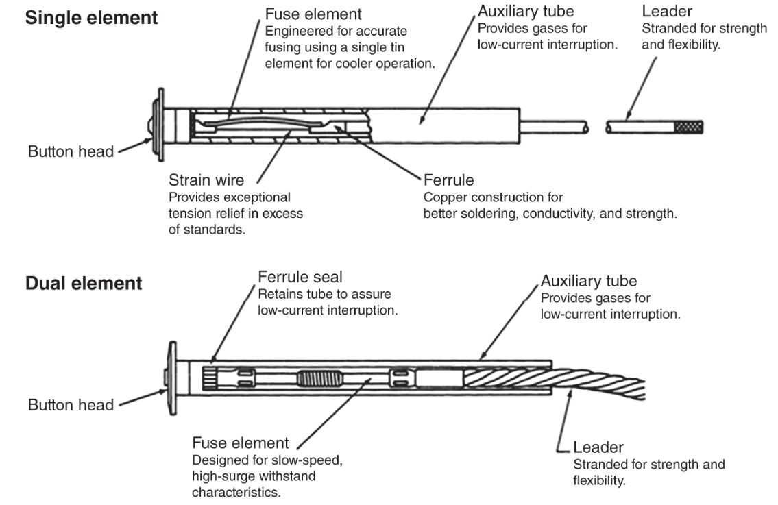
4.1.1 Expulsion Fuses
The principal component of a fuse link is a fusible element, made of various materials, including silver. The fusible element is housed inside a fuse cutout as shown in the figure.
Fig: Fuse-link construction

Slide 16
4.1.1 Expulsion Fuses
The time–current characteristic is the most common and classical model used to determine its time of operation for a specific fault current. The fuses are available with single or dual elements. The latter reduce the long-time minimum melt currents without reducing the short-time melt currents.

Slide 17
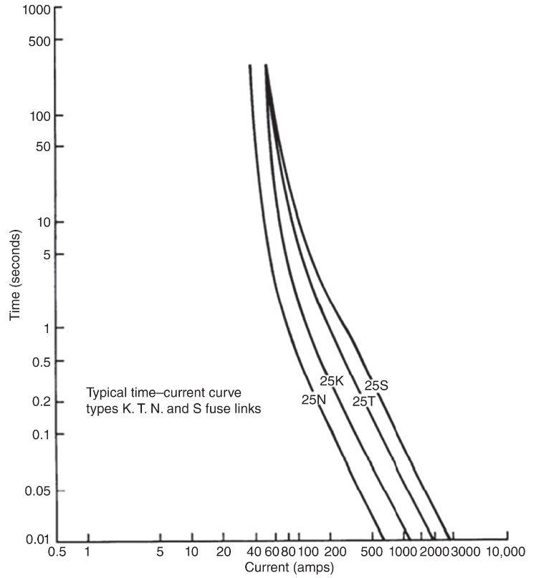
4.1.1 Expulsion Fuses
There are distinct types of expulsion fuses, which are designed to carry 100% of their rated current continuously.
Operating characteristics of fuse links are determined are distinguished by the speed of operation defined by the speed ratio as shown in the figure.
Fig: Comparison of various fuse links

Slide 18
4.1.1 Expulsion Fuses
Speed ratio of the fuse links of 100 A and below is the ratio of the current that melts the fuse link in 0.1 second to the current that melts the fuse in 300 seconds
Speed ratio of the fuse links of rated greater than 100A, is defined as the ratio of the current that melts the fuse link in 0.1 and 600 second.
Fig: Comparison of various fuse links

Slide 19
4.1.1 Expulsion Fuses
K link – “fast type” with speed ratio of 6–8.1. These are commonly used for urban systems.
N link – This is also “fast type” with speed ratio of 6–11.
T link – “slow type” with speed ratio of 10–13. These are suited for suburban systems.
S link – These are “very slow” with speed ration of 15–20.
Fig: Comparison of various fuse links

Slide 20
4.1.2 Vacuum Fuses
Vacuum fuses enclose the fusible element within a vacuum medium. Internal features of vacuum fuses include arc runners, shield, and ceramic insulation.
Multiple cycles may be necessary for low fault currents to burn back the fusible element. Vacuum fuses can be used indoors and under oil environments

Slide 21
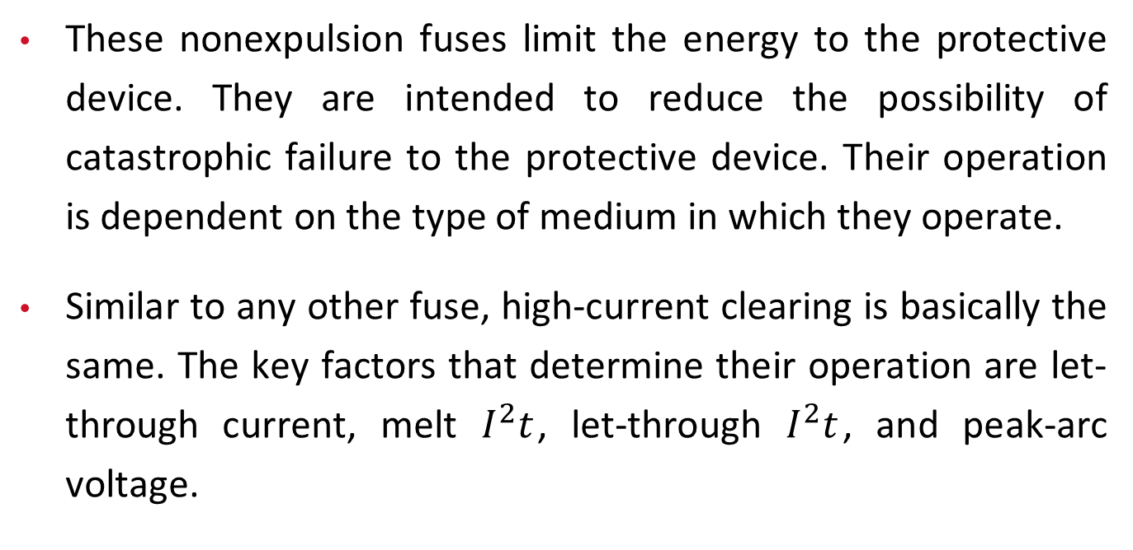
4.1.3 Current-limiting Fuses
These nonexpulsion fuses limit the energy to the protective device. They are intended to reduce the possibility of catastrophic failure to the protective device. Their operation is dependent on the type of medium in which they operate.
Similar to any other fuse, high-current clearing is basically the same. The key factors that determine their operation are let-through current, melt $I^{2}t$, let-through $I^{2}t$, and peak-arc voltage.

Slide 22
4.1.3 Current-limiting Fuses
Basic Types of Current-limiting Fuses:
Backup or Partial-range Fuse:
It must be used in conjunction with an expulsion fuse or some other device. It is capable of properly interrupting current only above a specified level.
General-purpose Current-limiting Fuse:
It is designed to interrupt all fault currents from its rated interrupting current down to the current that causes element melting in one hour.
Full-range Current-limiting Fuse:
It interrupts any continuous current (up to rated interrupting current) that will cause the element to melt.

Slide 23
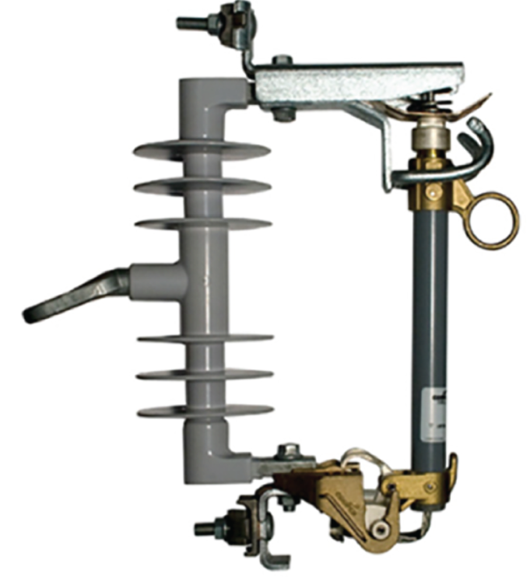
4.1.4 Distribution Fuse Cutouts
Figure shows an example of fuse cutout, which is a housing for connecting fuse link.
This arrangement assists the field crews to replace a burned fuse link with a new one.
Fig: Fuse Cutout

Slide 24
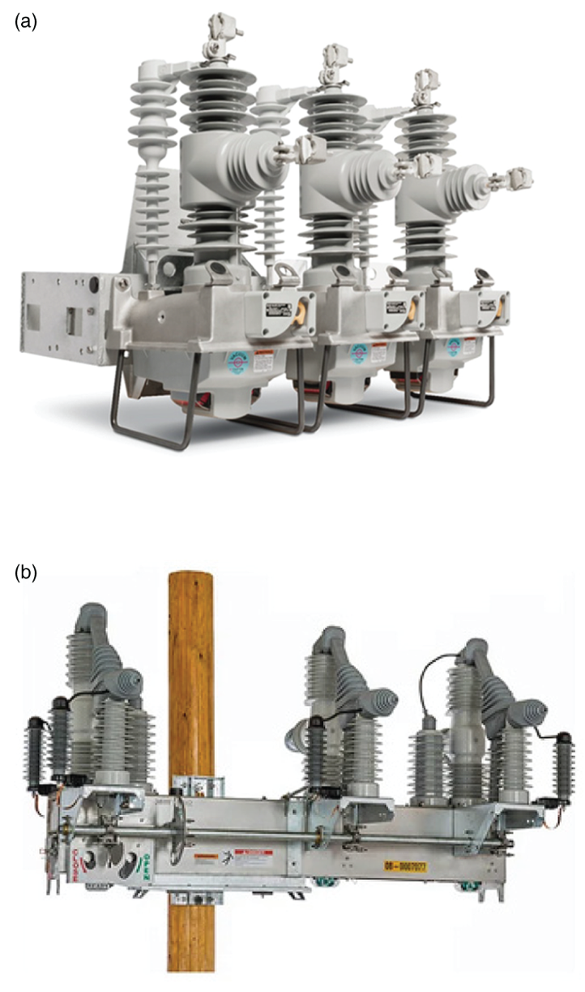
4.2 Automatic Circuit Reclosers
A recloser is a multifunction protective device with fault-sensing and fault-clearing capabilities. It is self-contained and intelligent, with the ability to sense overcurrent and interrupt the current flow, depending on the value of the current.
Designed to automatically reclose and reenergize the line. Modern reclosers often feature fully capable microprocessor relays.
Fig: Examples of modern Recloser (a) Nova NXT and (b) IntelliRupter PulseCloser

Slide 25
4.2 Automatic Circuit Reclosers
Examples of modern reclosers from different manufacturers are shown in figure. Reclosers are lighter than circuit breakers and mounted on poles in overhead distribution systems.
Fig: Examples of modern Recloser (a) Nova NXT and (b) IntelliRupter PulseCloser

Slide 26
4.2 Automatic Circuit Reclosers
Reclosers with advanced microprocessor protective relays are also commonly used at point of common coupling (PCC) to microgrids. Unlike fuse links, which interrupt either type indiscriminately, reclosers can distinguish between temporary and permanent faults.

Slide 27
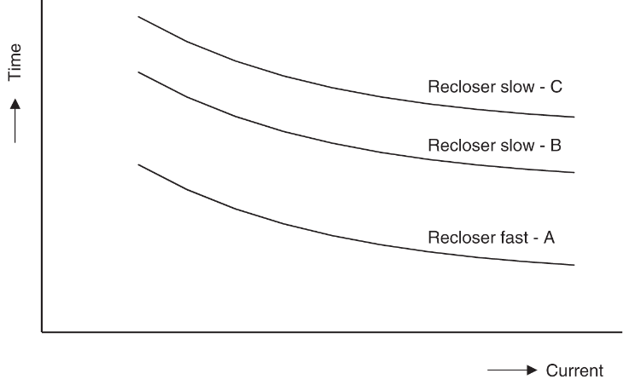
4.2 Automatic Circuit Reclosers
Figure shown depicts the time-current operating characteristics of a recloser. Reclosers typically have one fast (A) and one slow (C) or two slow (B and C) characteristics.
Fig: Example of recloser characteristics with one fast (A) and two slow curves (B and C)

Slide 28
4.2 Automatic Circuit Reclosers
An automatic circuit recloser trips and recloses a preset number of times to clear temporary faults or isolate permanent faults.
After a fault is detected, reclosers trip and automatically reenergize to “test” the line by successive “reclose” operations while giving temporary faults repeated chances to clear or be cleared by downstream protective devices. Should the fault not clear, the recloser recognizes it as a permanent fault and locks open or “locks out.”
A drawback of many reclosers is limited fault interruption capability. Reclosers must be coordinated with upstream protective relay-controlling circuit breakers in a substation. These circuit breakers are designed for interrupting fault currents.

Slide 29
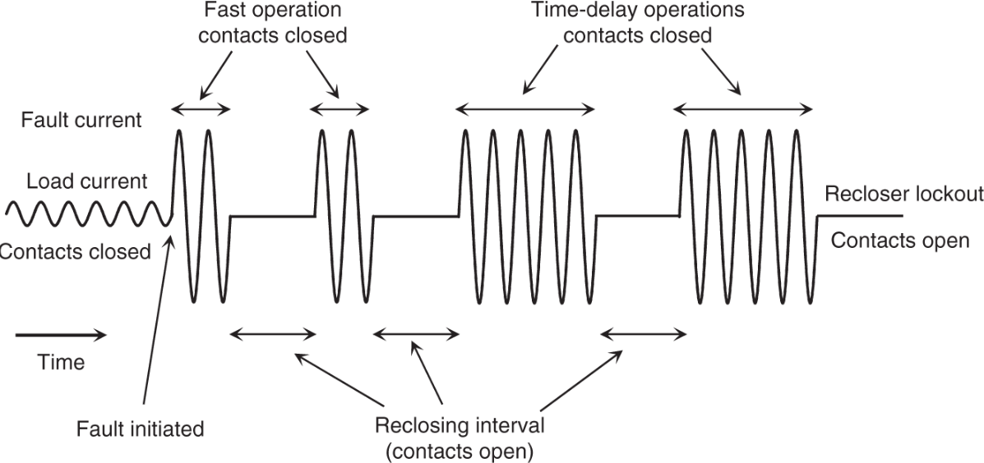
4.2 Automatic Circuit Reclosers
Figure shows two fast and two slow operations of a recloser. If Curve C is used for slow operations, the operating sequence is called 2A2C. Similarly, if Curve B is used for slow operations, the operating sequence is called 2A2B. The second two operations are deliberately slowed to allow the fault to clear if it is temporary or a downstream fuse to clear it if it is permanent.
Fig: Typical recloser operating sequence to lockout

Slide 30
4.2 Automatic Circuit Reclosers
In this example, the recloser opened and locked out after the third reclosing action because the fault was either not cleared by the downstream fuse or it was upstream of the fuse.
Fig: Typical recloser operating sequence to lockout

Slide 31
4.2.1 Recloser Classifications
Reclosers are classified as single phase for single-phase lateral applications and three phase for three-phase feeders. They can be hydraulically or electronically controlled. The interrupting media could be oil or vacuum. Modern reclosers are usually electronically controlled.

Slide 32
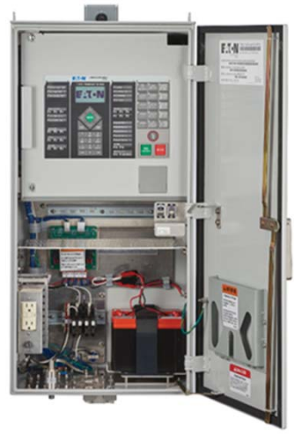
4.2.1 Recloser Classifications
Figure shows a control box for the recloser. Most reclosers interrupt fault current in oil-filled chambers, but recent designs have been built around vacuum circuit interruption.
Fig: Control box for a recloser. Source: Courtesy of Eaton Corporation.

Slide 33
4.3 Sectionalizers
Sectionalizers are circuit-interrupting devices similar to reclosers but can be less expensive if they do not have fault-interrupting mechanisms.
While the legacy sectionalizers did not have fault‐interrupting capability, most of the modern sectionalizers are reclosers programmed to operate as sectionalizers.
A sectionalizer applied in conjunction with a recloser or circuit breaker has the memory of counting the number of operations of the upstream device, but it does not have any fault‐interrupting capability of its own.
It counts the number of operations of the backup device (recloser or circuit breaker) during fault conditions, and after a preselected number of current‐interrupting operations (reclose attempts), the sectionalizer opens and isolates the faulted section of line.

Slide 34
4.3 Sectionalizers
If the fault is temporary, both the sectionalizer and the recloser reset to the normal state.
If the fault is persistent, however, the recloser operates on its sequence, but the sectionalizer isolates the fault before the recloser starts its final reclose operation; thus, recloser lockout is avoided, and only that portion of the circuit beyond the sectionalizer is interrupted.

Slide 35
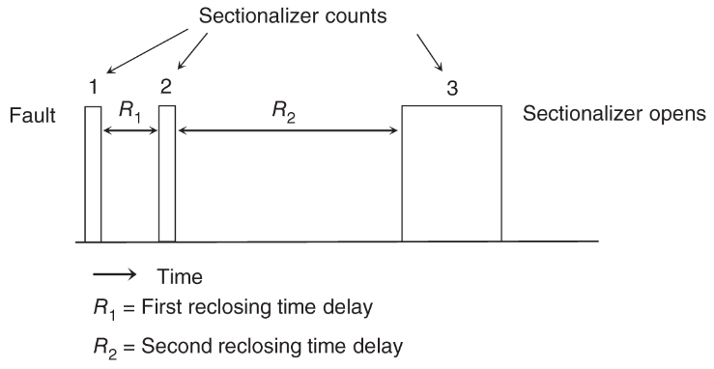
4.3 Sectionalizers
The figure illustrates the operating sequence of a sectionalizer set for three counts working with a four-sequence operation of a recloser on the upstream side.
Fig: Operational sequence of a sectionalizer

Slide 36
4.3 Sectionalizers
Sectionalizers can be used between two protective devices with operating curves that are close together.
Sectionalizers can also be used on close‐in taps where high fault magnitude prevents coordination of fuses with the backup recloser or breaker.
Sectionalizers are also ideal at locations where temporary faults could frequently occur.
They are designed to automatically reset with the mechanism provided in them.

Slide 37
4.4 Circuit Breakers
Circuit breakers are commonly employed at the substation level for overcurrent protection of the feeders connected to them.
They are mechanical switching devices capable of making, carrying, and breaking currents under short‐circuit or normal operating conditions.
Circuit breakers are expensive and bulky protective device which can only be cost justified at the substation level.

Slide 38
4.4 Circuit Breakers
Circuit breakers are classified by the interrupting medium and the method of storing energy:
Oil interruption
Vacuum interruption
Air‐blast interruption
SF6 (gas) interruption
Air‐magnetic interruption

Slide 39
4.4 Circuit Breakers
The medium in which the circuit interruption is performed may be designated by a suitable prefix, e.g. air-blast circuit breaker and gas circuit breaker.
Within the distribution systems, feeder breakers normally utilize oil, vacuum, or air magnetic as the interrupting medium and energy storage.

Slide 40
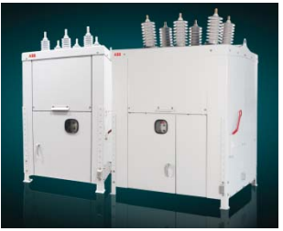
4.4 Circuit Breakers
Figure shows an example of 15-kV and 38-kV class circuit breakers, which are air insulated and interruption is done in vacuum.
Fig: Examples of 15-kV and 38-kV circuit breaker. Source: Courtesy of ABB.

Slide 41
4.4 Circuit Breakers
Generally, relay‐controlled circuit breakers are preferred to reclosers due to their better accuracy. Thus, opening and closing of substation circuit breakers are always controlled by protective relays.
An automatic circuit breaker is equipped with a trip coil connected to a relay or other means, designated to open the breaker automatically under abnormal conditions, such as fault and overcurrent.
It is frequently used to restore service quickly after a line trips out owing to lightning or a temporary fault. The stored‐energy mechanisms in a circuit breaker are designed to close its contacts several times.

Slide 42
4.4 Circuit Breakers
These operations use:
(i) motor‐compressed spring for one closing/opening operation with spring reset within 10 seconds,
(ii) compressed air or other gas for two closing/opening operations,
(iii) pneumatic or hydraulic breakers for higher numbers such as five closing/opening operations.

Slide 43
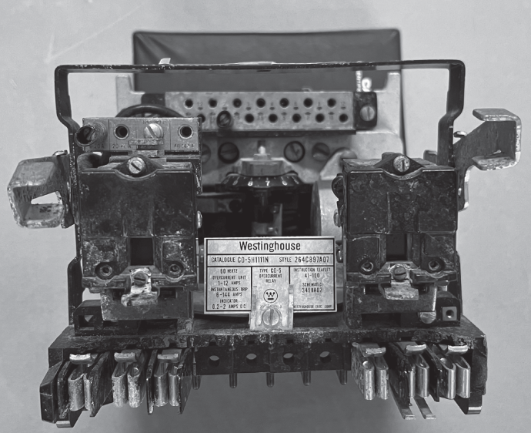
4.5 Time Overcurrent Relays
Historically, the classical electromechanical protective relays have been in existence since the dawn of electricity in the early 1880s. Electromechanical relay designs evolved through the 1950s. The image of the inside of a vintage Westinghouse electromechanical overcurrent relay shot by the authors is shown in Figure.
Fig: Electromechanical Overcurrent Relay

Slide 44
4.5 Time Overcurrent Relays
Most of the world still uses these devices and they will continue to be utilized for the foreseeable future. Electromechanical relays are reliable; however, they cannot perform complex or adaptive protection and cannot advise operations about their own failure.
Relays have the intelligence to detect an abnormal condition and send proper signals to circuit breakers to achieve automatic tripping and closing of the circuit breaker contacts.
For primary distribution systems, sensing function requires instrument transformers to step down both voltages and currents to standard 120 V and 5 A.

Slide 45
4.5 Time Overcurrent Relays
For example, for a 10‐MVA, 115‐kV/12.47‐kV three‐phase substation transformer, a voltage transformer (VT) with turns ratio of 60 : 1 will be required to step down 7.2 kV (L–N voltage on the low‐voltage side) to 120 V. Similarly, a current transformer (CT) with turns ratio of 500 : 5 will be needed to step down the full load current of 463 to a lower value suitable for relays.
The time-inverse overcurrent relay is the most used relay for overcurrent protection. This relay has plugs to select tap setting (TS), which is the minimum current at which the relay starts operating. Typical TSs range from 1 to 12 A.

Slide 46
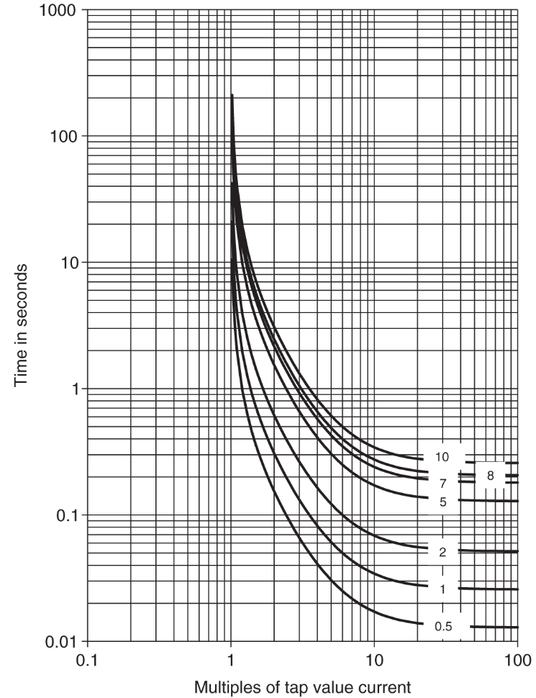
4.5 Time Overcurrent Relays
The other setting on these relays is the time dial (TD) setting, which delays the operation of the relay, with values ranging from 0.5 to 11.
The figure illustrates the characteristics of a commonly used time-inverse overcurrent relay (CO-8), with the x-axis representing multiples of tap value current or multiples of tap setting (MTS).
MTS is obtained by dividing the current flowing in the relay by selected TS.
Fig: Time–current characteristics of CO‐8 time‐inverse overcurrent relay at different time dial values.

Slide 47
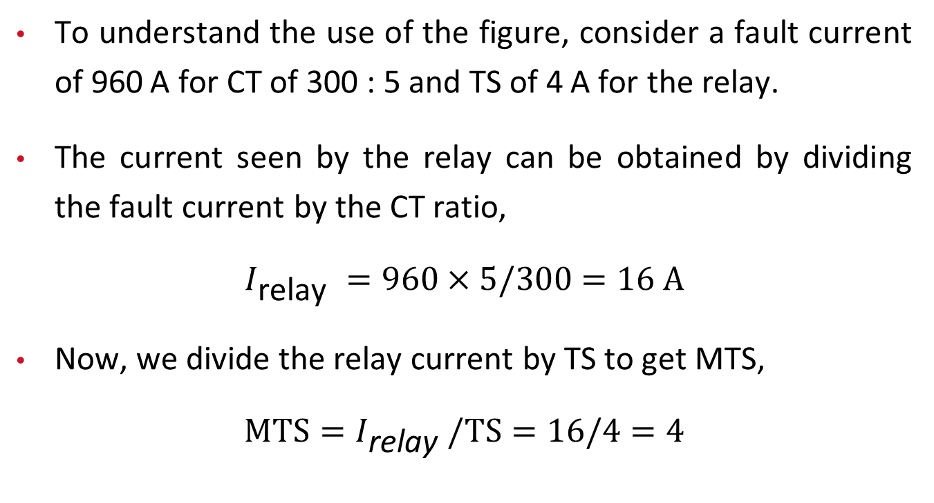
4.5 Time Overcurrent Relays
To understand the use of the figure, consider a fault current of 960 A for CT of 300 : 5 and TS of 4 A for the relay.
The current seen by the relay can be obtained by dividing the fault current by the CT ratio,
$$I_{\text{relay} }=960×5/300=16 A$$
Now, we divide the relay current by TS to get MTS,
$$MTS=I_{\text{relay} }/TS=16/4=4$$

Slide 48
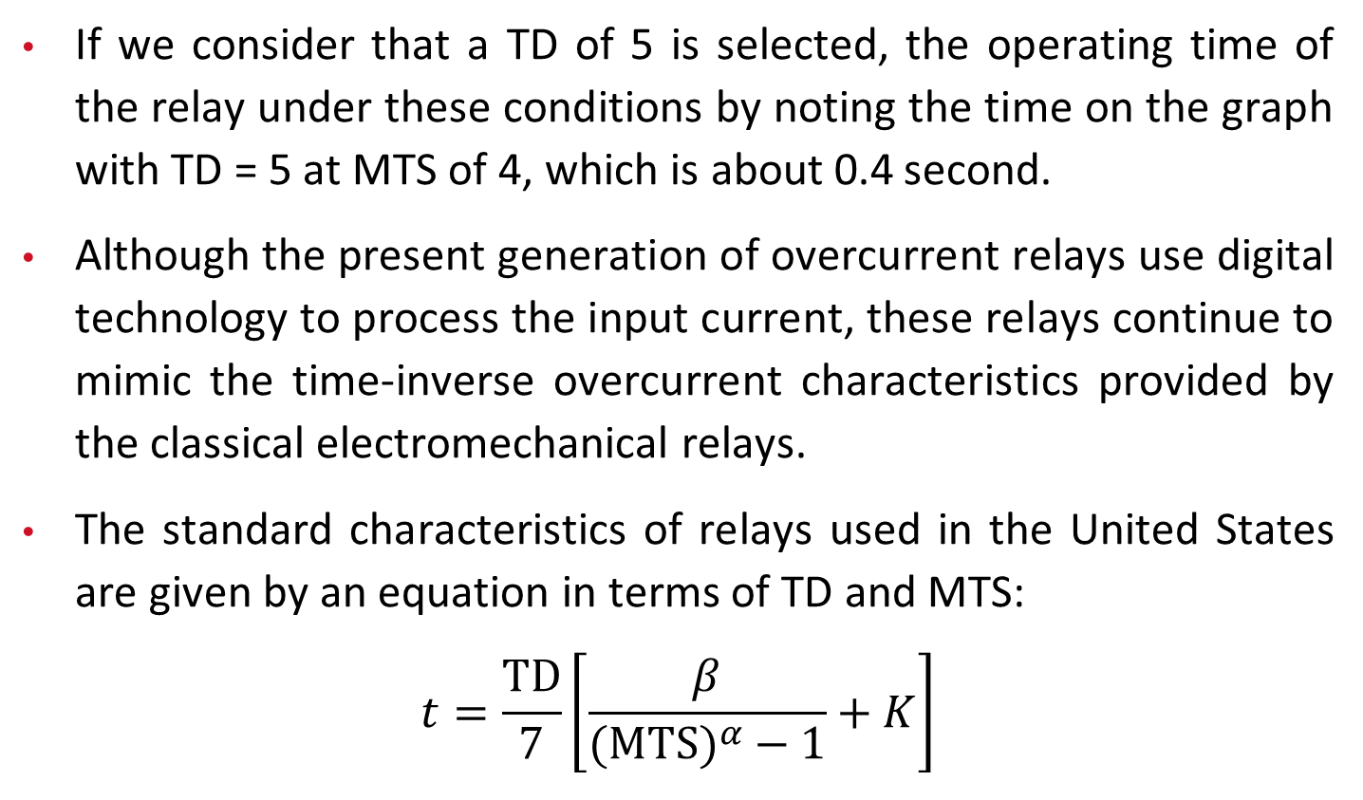
4.5 Time Overcurrent Relays
If we consider that a TD of 5 is selected, the operating time of the relay under these conditions by noting the time on the graph with TD = 5 at MTS of 4, which is about 0.4 second.
Although the present generation of overcurrent relays use digital technology to process the input current, these relays continue to mimic the time‐inverse overcurrent characteristics provided by the classical electromechanical relays.
The standard characteristics of relays used in the United States are given by an equation in terms of TD and MTS:
$$t=\frac{TD}{7}\left[\frac{β}{(MTS)^{α}−1}+K\right]$$

Slide 49
4.5 Time Overcurrent Relays
where t is the operating time of the relay, and 𝛼, 𝛽, and K are constants, which have specified values for different relay types as shown in Table.
characteristic | a | β | K
IEEE extremely inverse | 2 | 28.2 | 0.1217
IEEE very inverse | 2 | 19.61 | 0.491
CO8 inverse | 2 | 5.95 | 0.18
IEEE moderately inverse | 0.02 | 0.0515 | 0.114
CO₂ short time inverse | 0.02 | 0.02394 | 0.01694
Table: Constants for different time‐inverse overcurrent relays.

Slide 50
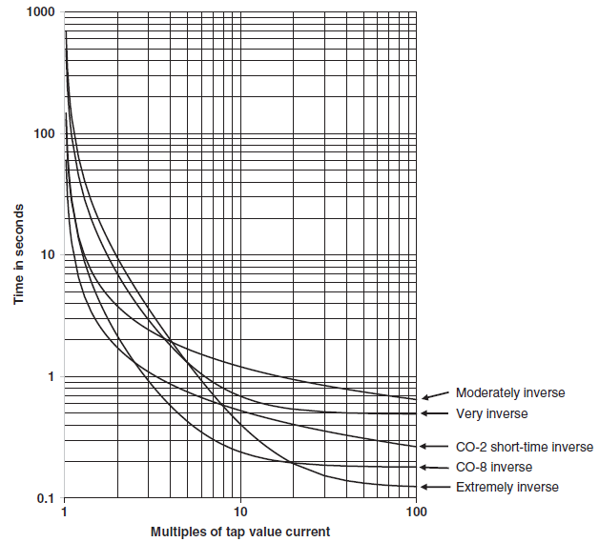
4.5 Time Overcurrent Relays
The corresponding graphs for these relays are shown in Figure on the right. The equations and constants for International Electrotechnical Commission (IEC) relays used in Europe are available in .
Fig: Time–current characteristics of different time‐inverse overcurrent relays at time dial of 7.

Slide 51
4.6 Static or Solid-state Relays
Static relays do not have moving parts, unlike electromechanical relays. The invention of transistors enabled the development of static relays. Static relays are more accurate and have faster response times compared to electromechanical relays.
These relays require high-quality DC power supplies, which are not so practical in substation environments. Solid-state or static relays emerged in the early 1960s but had low reliability, leading to their short lifespan.

Slide 52
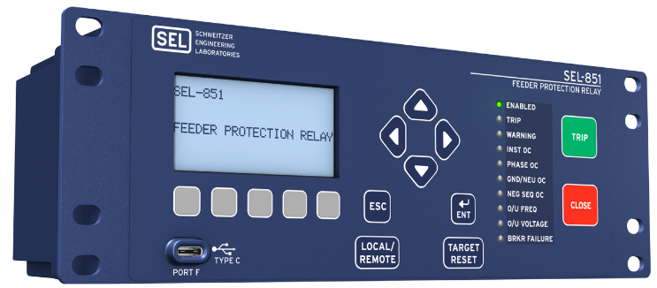
4.7 Digital or Numerical Relays
Digital or numeric relays emerged in the mid-1980s with the availability of low-cost microprocessors. They have become the preferred choice due to their multifunction capabilities and high accuracy. Figure shows a modern digital relay for overcurrent protection of distribution system feeders.
Fig: A modern digital relay for protection of distribution system feeders. Source: Courtesy of Schweitzer Engineering Laboratories.

Slide 53
4.7 Digital or Numerical Relays
Digital relays are becoming increasingly reliable and are now the preferred choice for protection of circuits from 480V to 765 kV. In addition to performing the most complicated protection and control functions, digital relays have self-diagnosis capabilities and advise operations if they are failed.
These relays are now commonly used as both protective relays and microgrid controllers. The digital relays have revolutionized protection with functions never possible including breaker failure, digital communications, adaptive protection, subcycle fast protection, and harmonic restraints, to name a few.

Slide 54
4.7 Digital or Numerical Relays
These multifunction devices represent a significant advancement in parts, cost, and maintenance in a substation.
Substations before the digital relay were always commonly manned. These new relays have provided better data collection for continuous monitoring and event root cause analysis than ever before possible.

Slide 55
4.8 Load Break Switch
This is a circuit disconnect device designed to make or break a circuit at specified currents.
Load break switches have some auxiliary equipment to increase the speed of the disconnect switch blade and alter the arcing phenomenon to allow safe interruption.

Slide 56
4.9 Circuit Interrupter
Device designed to open and close a circuit by nonautomatic means and to open the circuit automatically at a predetermined overcurrent value without damage to the device when operated within its rating.

Slide 57
4.10 Disconnecting Switch
This is a mechanical device having a movable member adapted to connect or disconnect the contact members to which conductors are securely bolted. Disconnecting switches are usually operated on dead circuits only but are sometimes operated on energized low-capacity circuits where the arc cannot sustain and extinguishes by itself.
These switches were used commonly for the earliest low-voltage circuits. As currents and voltages increased, it was found that the arc burns while opening the switch damaged or destroyed the contacts.

Slide 58
4.11 Sectionalizing Switch
Sectionalizing switch is a general term used to describe any switch that allows breaking the feeder into multiple sections but does not have any other function. Thus, both a disconnecting switch and load break switch are sectionalizing switches. However, sectionalizers and reclosers are not sectionalizing switches.

Slide 59
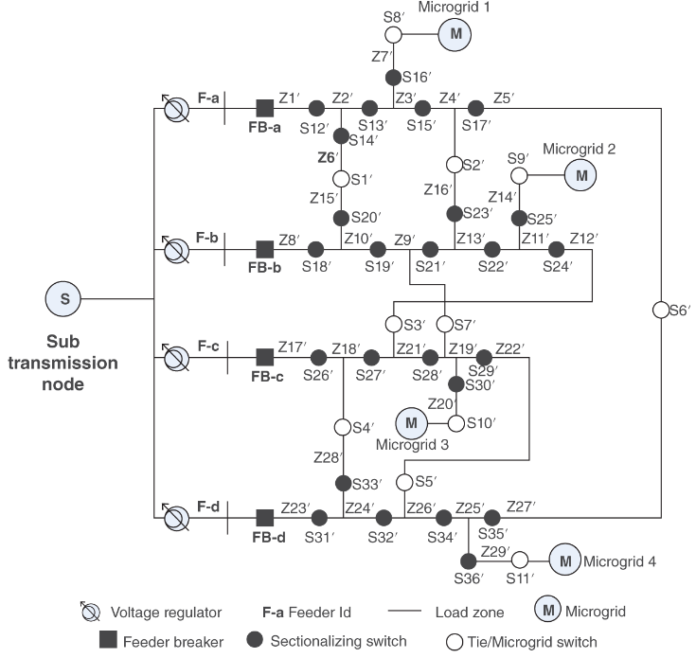
4.12 Example Distribution Systems
Figure shows the layout of a distribution system in which several sectionalizing switches are deployed.
The solid circles are used for sectionalizing switches on the feeders (normally closed), and open circles are used for end-of-the-feeder tie switches (normally open).
Fig: A typical distribution system depicting various components including tie and sectionalizing switches

Slide 60
5 New Generation of Devices
5.1 Smart Switching Devices
Recent advances in technology have resulted in a new class of smart switching devices.
The concept of these devices is still in several stages of development. A lot more research needs to be done before one could realize an automated fuse or a similar device.
A brief description of some of these devices under development follows.

Slide 61
5.1.1 Smart Fuses
A smart fuse device is a combination of a conventional fuse with intelligent sensor that simulates conventional current-limiting characteristics during high current faults and has the inherent ability to self-monitor and the capability to be triggered from an external source.
Still the fuse needs to be replaced manually after it melts when it blows following a fault. The smart fuse can be used for both substation transformer and secondary conductor overcurrent protection.

Slide 62
5.1.1 Smart Fuses
The device allows the medium voltage system to be grounded with a low resistance to minimize ground fault currents while still allowing coordination between upstream and downstream devices.
It provides protection against single phasing without sacrificing the current-limiting features.

Slide 63
5.1.2 Smart Reclosers (Interrupters)
A smart recloser is a combination of a recloser with some form of intelligence and control incorporated to achieve automation. One such device was developed by S&C Electric in 2008.
This Wi-Fi-enabled electrical equipment is a kind of “smart switch” that utilities use to more quickly detect and correct outages along their distribution systems.

Slide 64
5.1.3 Smart Circuit Breakers
Most of the AC circuit breakers deployed in the field are simple, electromechanical devices that sit idle most of the time.
But the latest versions are coming with features such as wireless connectivity and computing power that are meant to turn them into something more like a smart meter or a smartphone.

Slide 65
6. Basic Rules of Classical Distribution Protection
All faults must be given a chance to be temporary by providing a reclosing operation for a fault anywhere on the system where momentary outages are acceptable.
In responding to faults found to be permanent after the designated number of reclosing operations have been performed, the protection devices must remove from service only the smallest possible portion of the system necessary for isolation of the faulted segment.

Slide 66
6. Basic Rules of Classical Distribution Protection
This assures that minimum number of customers are affected and thus assures higher reliability for the system under study. Data on overcurrent relays, reclosers (courtesy of Eaton Corporation), and selected fuse links (courtesy of S&C Electric) are too large for inclusion in the book, but they are available on the book’s companion website.

Slide 67
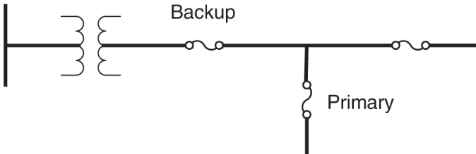
6. Basic Rules of Classical Distribution Protection
By conventional definition, when two or more protective devices are applied to a system, the device nearest to the fault on the supply side is the “primary” device. The other ones toward the upstream are called the “backup” devices, as shown in the Figure.
Fig: Operational convention for protective device

Slide 68
6. Basic Rules of Classical Distribution Protection
To minimize the effects of faults on the main feeder, sectionalizing devices can be used to divide the feeder into smaller segments using devices such as reclosers, sectionalizers, and/or a combination of both.
All taps branching off the feeder should have a protective device where it connects to the main feeder：
Fuses are normally used for taps serving single‐phase loads for short distances (less than a mile).
Reclosers and sectionalizers are utilized for large taps serving larger loads for longer distances.

Slide 69
6. Basic Rules of Classical Distribution Protection
The fast‐trip curve of the recloser is used to clear temporary faults on the main feeder and taps. For permanent faults on taps, the recloser time-delay curve allows the tap fuse to clear, resulting in an outage on the tap only.
Reclosers reduce the operation of fuses for temporary faults, but they can cause momentary interruptions on main feeders, which can be detrimental to certain loads.

Slide 70
6. Basic Rules of Classical Distribution Protection
Momentary interruptions can be reduced by midpoint sectionalizing devices. Critical industrial or commercial loads can be protected by installing a recloser on the main feeder just downstream from the point of coupling of the critical load.
Reclosers can also be added to longer taps off the main feeders to relieve momentary interruptions caused by faults on the tap.

Slide 71
7. Coordination of Protection Devices
Distribution protection coordination is a complex process with multiple variables and valid solutions.
The art of protection plays a crucial role in achieving effective coordination.
Coordination is particularly relevant for traditional distribution systems with radial topology and one-way power flow.
Proper coordination of protective devices offers benefits such as eliminating service interruptions from temporary faults, minimizing the impact on customers, and optimizing service restoration.

Slide 72
7. Coordination of Protection Devices
To conduct proper coordination, the following data are required:
Feeder configuration diagram.
Location of protective devices.
Mathematical models of protective devices, including their time-current characteristics.
Expected range of normal load currents at all locations within the system.
Expected range of fault currents at all locations within the system.

Slide 73
7.1 General Coordination Rule
The classical coordination of two local devices is performed using time–current coordination characteristics, which form the models for the devices. Essentially, two successive adjacent devices are coordinated proceeding from the load side to the source side for all device pairs and all feeder segments in the system.
The objective is to keep a minimum coordination time interval between the primary device close to the point of fault and the immediate backup device(s), depending on the topology of the system.

Slide 74
7.1 General Coordination Rule
This process should be repeated for all device pairs in the system. The coordination of results tends to be very subjective because of the very nature of protection. One could conceive of multiple successful solutions for the exact fault situation.

Slide 75
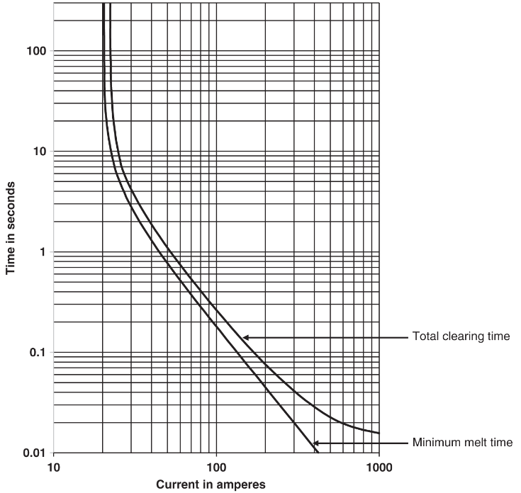
7.2 Fuse – Fuse Coordination
7.2.1 Model for Fuses
Fuse is an overcurrent device with a circuit-opening fusible member, which is directly heated and destroyed by the passage of overcurrent in the event of an overload or short circuit. Thus, the time needed to melt the fuse link decreases with increase in current.
The inverse-time melting characteristics of a fuse link are represented by the minimum-melting curve (MMC) and the total clearing curve (TCC) as depicted in Figure.
Fig: Time-current model of 10K fuse link

Slide 76
7.2 Fuse – Fuse Coordination
7.2.1 Model for Fuses
The difference in two curves is the arcing time within the fuse. Typically, a new fuse will follow these curves. However, over time with multiple overloading situations, the melting time will decrease. The damaging time curve is approximately 75% of the MMC. The 25% margin considers some operating variables such as ambient temperature and loading.
Fig: Time-current model of 10K fuse link

Slide 77
7.2 Fuse – Fuse Coordination
7.2.1 Model for Fuses
This margin is subjective in nature, and different values can be used, depending on the climate and operating conditions at the specific location. Note that the 10K fuse link starts to melt at 20 A, which is twice the rating of the fuse.
As a general rule, fuse link rating must be greater than the full load value divided by 1.5. Therefore, 10K fuse link will be appropriate for full load less than 15 A.
Although general equations to model different fuse links are not available, some researchers have attempted to develop equations for fuse links. Most often, fuse link characteristics are digitized for use in computer-based coordination software.

Slide 78

7.2.2 Rule for Fuse–Fuse Coordination
Figure shows a simple radial feeder. For the fault at the location shown in the figure, to coordinate fuse links A and B successfully, the total clearing time curve of B must be lower than the damaging time curve of fuse A within the desirable coordination current range.
Fig: Fuse – Fuse Coordination of a simple radial system

Slide 79
7.2.2 Rule for Fuse–Fuse Coordination
According to the damaging curve, as the name implies, the fuse deteriorates whenever the current reaches or exceeds the corresponding value. A generally acceptable method is that the total clearing time of B should not exceed 75% of the minimum melt time (MMT) of A. This coordination procedure can be further illustrated with the example provided in the next slide.
Fig: Fuse – Fuse Coordination of a simple radial system

Slide 80
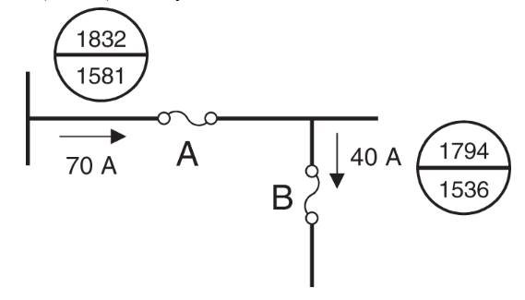
7.2.2 Rule for Fuse–Fuse Coordination
Example
Figure shows part of a 12.47‐kV distribution system with maximum fault, minimum fault, and full load current at the respective fuse link locations. We select fuse links Type T for locations A and B to achieve proper protection with coordination between the two fuse links.
Fig: Part of a distribution system protected by fuse links.

Slide 81
7.2.2 Rule for Fuse–Fuse Coordination
Solution
As the first step, we select the fuse links based on the specified full load. For location B, the fuse link must have rating higher than 40/1.5 = 26.66 A, and for location A, it must have a rating higher than 70/1.5 = 46.66 A. A 30T fuse link for location B and a 50T for location A will work. However, we have to make sure that they follow the coordination rules.

Slide 82
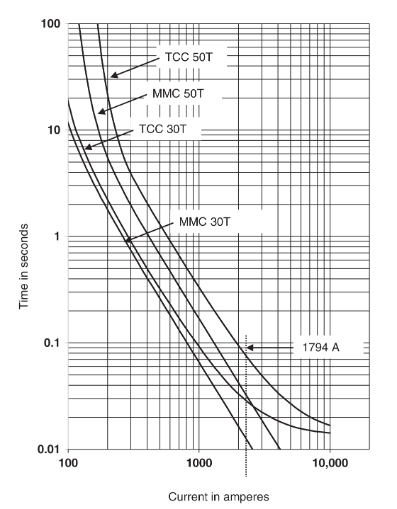
7.2.2 Rule for Fuse–Fuse Coordination
Solution
Figure on the right shows the MMC and TCC of the two selected fuse links. The critical current for coordination is 1794 A, which is the maximum fault current seen by both fuse links.
Fig: MMC and TCC curves of 30T and 50T fuse links and their coordination at the maximum fault of 1794 A.

Slide 83
7.2.2 Rule for Fuse–Fuse Coordination
Solution
The total clearing time of 30T is 0.037 seconds, and the MMT of 50T is 0.05 seconds at this current. The ratio of these two times is 0.037/0.05 = 0.74, which is acceptable because this ratio must be lower than 0.75.

Slide 84
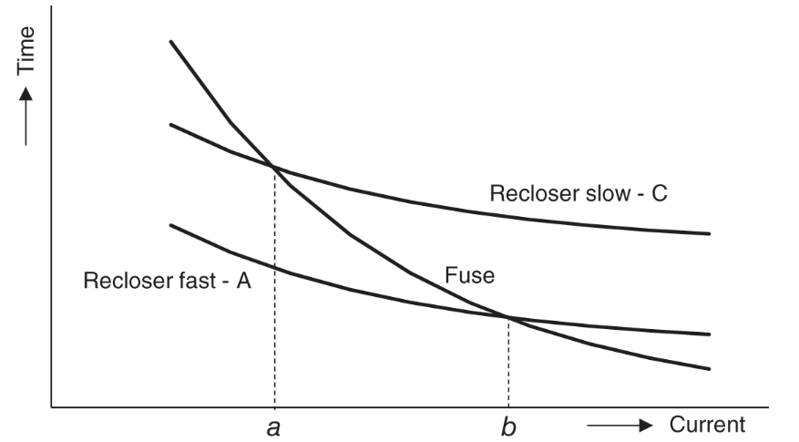
7.3 Recloser – Fuse Coordination
Figure a shows a typical model for a recloser, which is time versus current curve. It has a fast curve A and time delay curve C.
Fig. a: Time–current characteristic curve for a recloser and a downstream fuse link

Slide 85
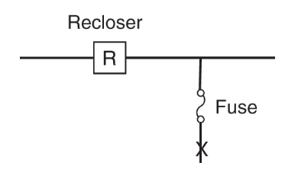
7.3 Recloser – Fuse Coordination
The curve in the middle is that of the downstream fuse link, shown in Figure b. The fuse link curve intersects the slow and fast curves of the recloser at “a” and “b,” which give the minimum fault current and the maximum fault current for which coordination between the recloser and the downstream fuse is required.
Fig. b: Recloser–fuse locations in a simple distribution feeder system.

Slide 86
7.3 Recloser – Fuse Coordination
The coordination should ensure that for permanent faults in downstream of the fuse, the fuse should clear the fault.
Similarly, for a permanent fault upstream of the fuse, the recloser should open. But for a temporary fault, none of the devices should stay open. Thus, for any fault downstream of the fuse, the recloser should operate on the fast curve first to open the recloser. This is followed by one reclosing and another fast-trip operation

Slide 87
7.3 Recloser – Fuse Coordination
If the fault is still there, the fast curve of the recloser is disabled, and the recloser follows two additional close and trip operations on the slow curve to allow the fuse to clear the fault if it is permanent and is downstream of the fuse.
If the fault is permanent, but upstream of the fuse, the recloser clears it by locking out after operating twice on the slow curve.

Slide 88
7.3 Recloser – Fuse Coordination
Determining values of “a” and “b” is important for proper coordination between the fuse and the recloser. Since the operating characteristics of these devices are not very precise and may change due to the operating conditions, some adjustments are implemented to account for manufacturing tolerance and the cumulative temperature rise in the fuse link during the recloser operations.
Hence, the recloser’s curves are multiplied by a factor called K-factor. These factors are derived experimentally for different operating conditions, and a value of 1.35 is typically used for the fast curve of the recloser with an operating sequence of two fast and two slow operations.

Slide 89
7.3 Recloser – Fuse Coordination
For an operating sequence of one fast and three slow operations, the multiplying factor reduces to 1.2 because the cumulative temperature rise is lower. Thus, for two fast and two slow operating sequences, the intersection of fuse damaging time curve (75% of minimal-melting-time curve) and fast-trip operation of the recloser scaled up to 1.35 gives the value of “b”.
The value of “a” is determined by the intersection of the maximum clearing curve of the fuse with the slow characteristics of the recloser.

Slide 90
7.3 Recloser – Fuse Coordination
Similarly, if there is a fuse upstream of the recloser, the multiplying factor must be used to scale up the recloser’s slow characteristics. Hence, for the maximum fault at the recloser location, the minimum melting time of the fuse must be higher than the average clearing time of the recloser on the slow curve multiplied by the specified multiplying factor. The suggested multiplying factors range from 1.7 to 3.5 based on the recloser type, the reclosing time (30–120 cycles), the recloser operating curves, and the operating sequence.

Slide 91
7.3 Recloser – Fuse Coordination
Tables a and b give recommended K-factor values for coordination with upstream and downstream fuse links.
Table a. Recloser K-factors for coordination with source-side fuse links.
Reclosing time in cycles | Two fast and two delayed sequences | One fast and three delayed sequences | Four delayed sequences
25 | 2.7 | 3.2 | 3.7
30 | 2.6 | 3.1 | 3.6
50 | 2.1 | 2.5 | 2.7
90 | 1.85 | 2.1 | 2.2
120 | 1.7 | 1.8 | 1.9
240 | 1.4 | 1.4 | 1.45
600 | 1.35 | 1.35 | 1.35
Source: Courtesy of Eaton Corporation.

Slide 92
7.3 Recloser – Fuse Coordination
Tables a and b give recommended K-factor values for coordination with upstream and downstream fuse links.
Table b. Recloser K-factors for coordination with load-side fuse links.
Reclosing time in cycles | Two fast operation | One fast operation
25-30 | 1.8 | 1.25
60 | 1.35 | 1.25
90 | 1.35 | 1.25
120 | 1.35 | 1.25
Source: Courtesy of Eaton Corporation.

Slide 93
7.3 Recloser – Fuse Coordination
We illustrate the local coordination philosophy with hierarchical approach for the feeder system with an example. The first step is to identify and enumerate all primary-backup device pairs in the given system.
Then, the coordination procedure should be conducted using the coordination rules discussed previously.

Slide 94
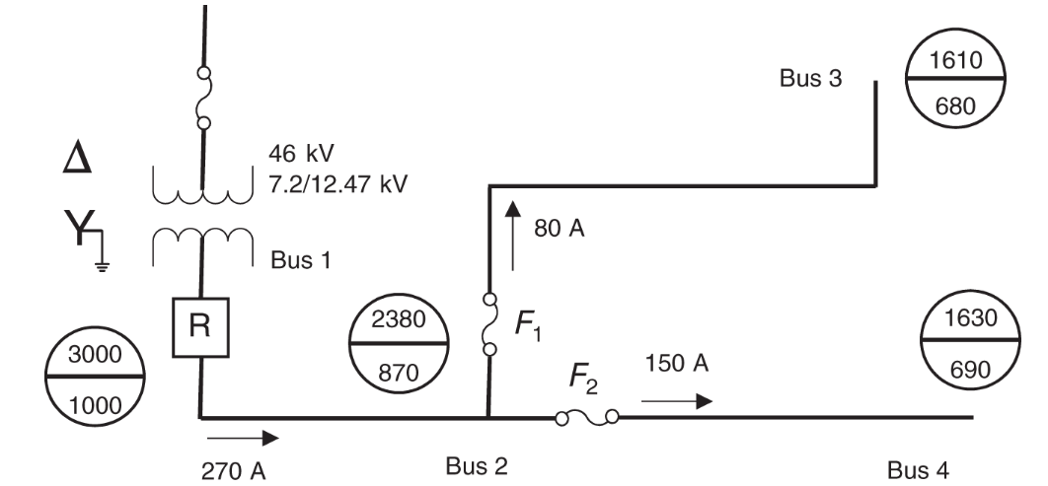
7.3 Recloser – Fuse Coordination
Example: Consider the system shown in the figure. The objective is to select recloser settings, fuses F1 and F2, and the fuse upstream of the transformer for the given system. The maximum and the minimum fault currents at distinct locations are shown in circles drawn to the locations. The maximum load currents at distinct locations are shown next to the arrows.
Fig: Example distribution system. Source: Courtesy of Eaton Corporation.

Slide 95
7.3 Recloser – Fuse Coordination
Solution
Recloser Selection
Since the maximum load current at Bus 1 is 270 A, it is necessary to choose a set of reclosers with a maximum continuous current rating higher than 270 A. This is achieved by employing three single‐phase reclosers type L with a trip coil rating of 280 A, which have a minimum trip rating of 280 A and interrupting capability of 4000 A. The interrupting capability is higher than the maximum fault current of 3000 A at Bus 1. Note that this selection limits the ability to increase the maximum load currents in the future without upgrading the reclosers.

Slide 96
7.3 Recloser – Fuse Coordination
Solution
Source‐side Fuse and Recloser Coordination
The source‐side fuse needs to be selected so that it does not melt for any fault currents on the load side of the recloser.
It means that for the maximum fault current seen by the recloser (3000 A), the minimum melting time of the fuse must be greater than the clearing time of the recloser's delayed curve.
Some other factors as discussed below must be considered to select this fuse.

Slide 97
7.3 Recloser – Fuse Coordination
Solution
Transformer Turns Ratio
Since the source‐side fuse is on the primary side of the transformer, the turns ratio of the transformer needs to be considered because currents from the low‐voltage side have a smaller magnitude when seen from the high‐voltage side since power across the transformer must be equal. Given that the transformer turns ratio is N = 3.7, the fuse time–current curves across the transformer have the following multiplying factors due to Δ‐Y connection of the transformer:
Three‐phase fault: N = 3.7
Phase‐to‐phase fault: 0.87 * N = 3.2
Phase‐to‐ground fault: 1.73 * N = 6.4
The phase‐to‐phase fault current has the lowest multiplying factor, and it is used as the limiting factor for the source‐side fuse and recloser coordination because it results in the tightest requirement.

Slide 98
7.3 Recloser – Fuse Coordination
Solution
Continuous Load Current
The source‐side fuse also needs to consider the normal operating conditions, that is the continuous peak load current. In this case, the maximum continuous load current is 270 A on the low side of the transformer, which corresponds to 73 A of current on the high side of the transformer.
Generally, fuses start operating at currents that are greater than two times their rating. Thus, they can easily carry currents up to 1.5 times their rating. For instance, a 65E fuse link can carry up to 97.5 A of continuous current, and thus, it is suitable. For this example, we select a 46‐kV 65E slow fuse link.

Slide 99
7.3 Recloser – Fuse Coordination
Solution
Recloser K‐factor
The K‐factor value for the recloser is found according to the type of the recloser sequence and the reclosing intervals. For the recloser sequence of two fast operations followed by two delay operations, a K‐factor of 1.7 is used to scale the recloser's slow characteristics.

Slide 100
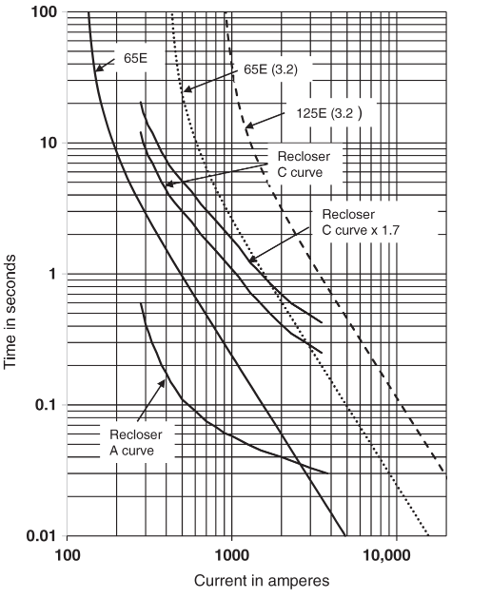
7.3 Recloser – Fuse Coordination
Solution
Selection
The Figure on the right shows the original and scaled versions of the fuse link and recloser curves. The operating time of the recloser's slow curve is multiplied by the K-factor, and the current is scaled by a factor of 3.2 for the fuse link curve.
Fig. Operating time of L‐type recloser and E‐type slow upstream fuse links.

Slide 101
7.3 Recloser – Fuse Coordination
Solution
Selection
The intersection of the MMC for a fuse link type 65ES and the modified C curve for the recloser is found at approximately 1800 A. A different fuse link is needed to ensure proper coordination at a fault current of 3000 A, with a gap between the MMC of the fuse link and the recloser operating time on the modified curve larger than 0.5 seconds.
Fig. Operating time of L‐type recloser and E‐type slow upstream fuse links.

Slide 102
7.3 Recloser – Fuse Coordination
Solution
Selection
The operating time of the recloser on the modified curve is 0.5 seconds at 3000 A. A fuse link with a melt time greater than 1 second (0.5 seconds + 0.5 seconds) is required for proper coordination.
The scaled MMC of slow 125E fuse link has a melt time slightly higher than one second for 3000 A. Fuse links higher than 125E will comply with the coordination requirement. Therefore, a 125E slow fuse link is chosen.
Fig. Operating time of L‐type recloser and E‐type slow upstream fuse links.

Slide 103
7.3 Recloser – Fuse Coordination
Load‐side Fuse and Recloser Coordination
Coordination between fuses F1 and F2 and the recloser needs to be set up so that:
In the event of a temporary fault between buses 2 and 3 or 4, neither F1 nor F2 burns out before the recloser's fast operation clears the fault.
In the event of a permanent fault, fuses F1 and F2 clear the fault by melting before the recloser's delay operation happens.

Slide 104
7.3 Recloser – Fuse Coordination
Continuous Load Current
Since the recloser has already been selected, it is necessary to choose appropriate fuse links to achieve proper coordination.
Considering the maximum continuous load currents, it is possible to find the minimum ratings of fuse links for F₁ and F₂. The load currents for F₁ and F₂ are 80 and 150 A, respectively. This means that for F₁ it is necessary to choose a rating of 65T or higher (80/1.5 = 53.333 A), and for F₂ it is necessary to choose 100T or higher (150/1.5 = 100 A).

Slide 105
7.3 Recloser – Fuse Coordination
Continuous Load Current
Like the slow curve, a K‐factor must be applied to the recloser fast curve. The K‐factor value of 1.35 can be found from the Table.
Table. Recloser K-factors for coordination with load-side fuse links.
Reclosing time in cycles | Two fast operation | One fast operation
25-30 | 1.8 | 1.25
60 | 1.35 | 1.25
90 | 1.35 | 1.25
120 | 1.35 | 1.25

Slide 106
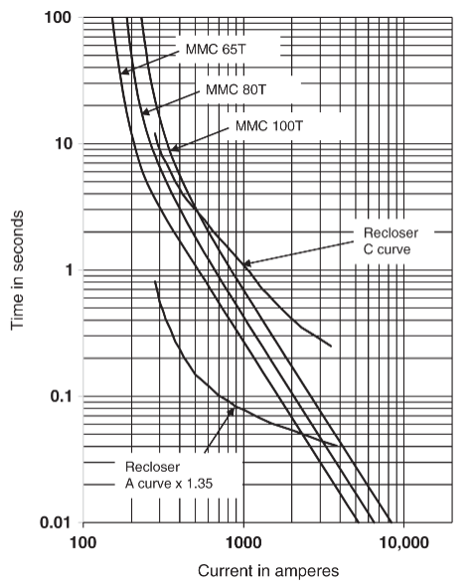
7.3 Recloser – Fuse Coordination
Minimum Melt Time (MMT)
The MMT of each of the fuses needs to be higher than the adjusted fast operation (curve A times 1.35) of the recloser between the minimum fault current (680 A for F1 and 690 A for F2) and the maximum fault current seen by the fuses (2380 A).
Fig: Adjusted fast curve (Curve A) of recloser and MMC of selected fuse links

Slide 107
7.3 Recloser – Fuse Coordination
Minimum Melt Time (MMT)
F1 and F2 MMT should be higher than 0.05 seconds for a current of 2380 A. Figure shows the A curve of the recloser times 1.35 and MMCs of 65T, 80T, and 100T fuse links. Both 80T and 100T meet the requirement, but 65T does not.
F1 and F2 MMT should be higher than 0.1 seconds for currents of 680 and 690 A. All the fuse links meet the requirement.
Fig: Adjusted fast curve (Curve A) of recloser and MMC of selected fuse links

Slide 108
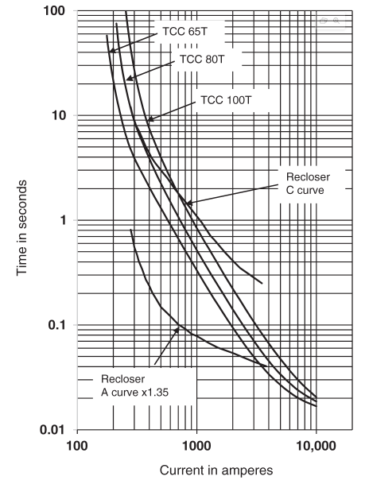
7.3 Recloser – Fuse Coordination
Maximum Clearing Time (MCT)
The maximum clearing time (MCT) of the fuses must be lower than the delayed operation (curve C) of the recloser for the maximum and minimum currents seen by the fuses.
Fig: Slow curve (Curve C) of recloser and TCC of selected fuse links.

Slide 109
7.3 Recloser – Fuse Coordination
Maximum Clearing Time (MCT)
F1 and F2 MCT should be lower than 0.37 seconds approximately for a current of 2380 A. Figure shows the C curve of the recloser and TCC of 65T, 80T, and 100T fuse links. All the fuse links meet the requirement.
F1 and F2 MCT should be lower than 1.8 seconds approximately for currents of 680 and 690 A, respectively. Both 65T and 80T meet the requirement, but 100T does not.
Fig: Slow curve (Curve C) of recloser and TCC of selected fuse links.

Slide 110
7.3 Recloser – Fuse Coordination
Selection
The analysis indicates that the only fuse that satisfies all the requirements is the 80T fuse.
Although the desired fuse for F1 was 65T, it needs to be increased to 80T to ensure adequate protection.
Similarly, the desired fuse for F2 was 100T, but it needs to be reduced to 80T for proper coordination with the recloser.
It's important to note that the 80T fuse will coordinate with the recloser, but it may melt under maximum loading conditions.

Slide 111
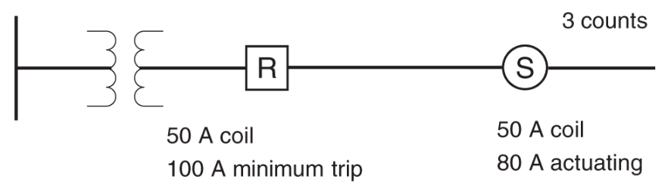
7.4 Recloser – Sectionalizer Coordination
The sectionalizer is set for one less operational count than the immediate recloser on the source side as shown in the figure. In this case, if the recloser is set for four operations, the sectionalizer should be set for three operations. The continuous current rating of both the devices should be the same. The actuating current of the sectionalizer is set to 80% of the recloser's minimum trip rating.
Fig: Basic sectionalizer–recloser coordination

Slide 112
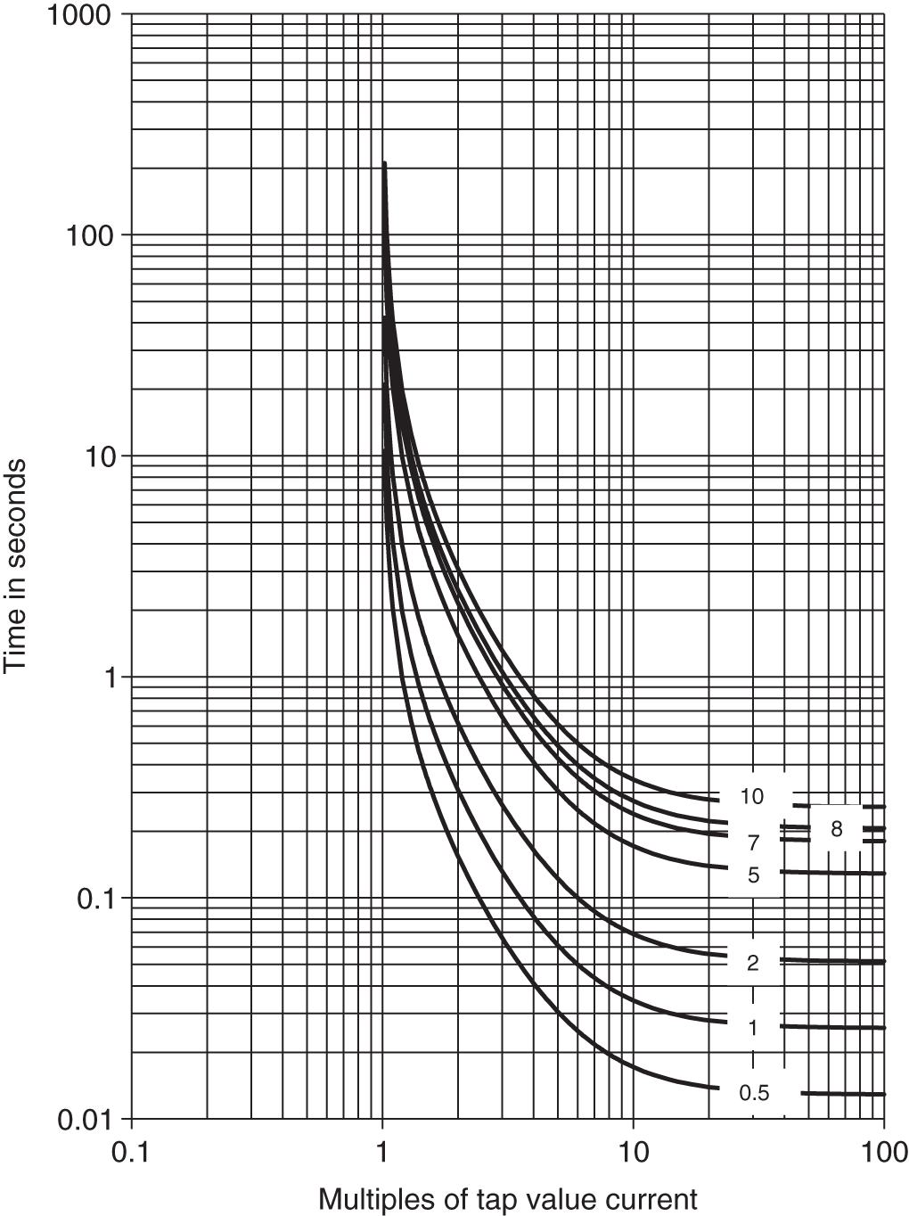
7.5 Circuit Breaker – Recloser Coordination
Models for Relay – Controlled Circuit Breakers
The overcurrent relay‐controlled circuit breakers have a time delay unit with characteristics similar to that shown in Figure, and an instantaneous unit.
The relay characteristics, its pickup value, and TD are selected based on the given load and fault currents. The relay type CO‐8 is used often.
Fig: Time–current characteristics of CO‐8 time‐inverse overcurrent relay at different time dial values.

Slide 113
7.5 Circuit Breaker – Recloser Coordination
Rules for Coordination
The relay time-current characteristics of the circuit breaker should be set above the characteristics of the primary device.
The pickup and time-dial settings of the relay should provide sufficient safety margin with the selected characteristics of the recloser or other devices.
The instantaneous relay characteristics should have a proper safety margin above the fast curves of the recloser or other devices.

Slide 114
7.5 Circuit Breaker – Recloser Coordination
Rules for Coordination
The time delay characteristics of the relay should allow the slow curves of the recloser to act first.
Static overcurrent relays are easier to coordinate with reclosers as they do not have issues of overtravel and coasting.
If mechanical relays are used, appropriate margins must be included to ensure proper coordination.

Slide 115
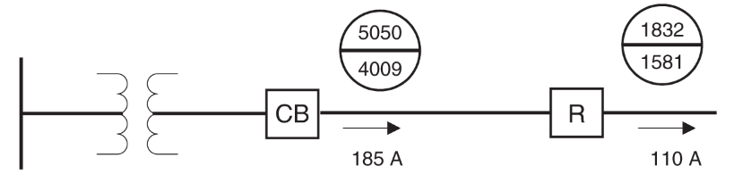
7.5 Circuit Breaker – Recloser Coordination
Example:
Figure shows an example of a distribution feeder protected by a recloser and a circuit breaker along with the minimum and maximum faults. Find settings of the relay for the CB to coordinate with the recloser.
Fig: Main feeder of a distribution system.

Slide 116
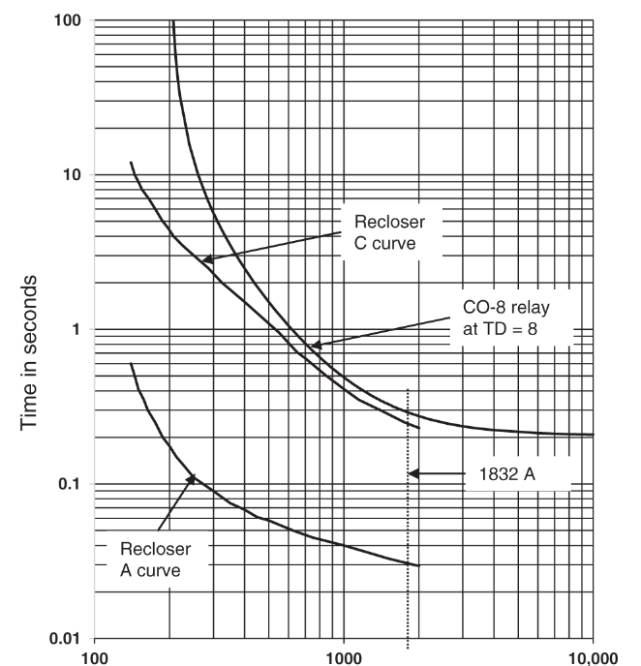
7.5 Circuit Breaker – Recloser Coordination
Solution:
The first step is to select a recloser. Since the full load current is 110 A, a recloser with 140A trip coil setting is appropriate. Figure on the right shows the recloser curves.
Fig. Recloser and CO‐8 relay‐operating curves.

Slide 117
7.5 Circuit Breaker – Recloser Coordination
Solution:
We select a CO-8 relay for the circuit breaker. For a load current of 185 A, 200 : 5 CT will work. Further, we select 5A as the TS for the CO-8 relay. This will allow some margin for overload on the feeder. Now, we have to select the TD setting for the relay to coordinate with the recloser. At 1832 A, which is the largest fault current seen by both the recloser and the circuit breaker, the recloser takes 0.24 seconds to operate on the slow curve (curve C).
Fig. Recloser and CO‐8 relay‐operating curves.

Slide 118
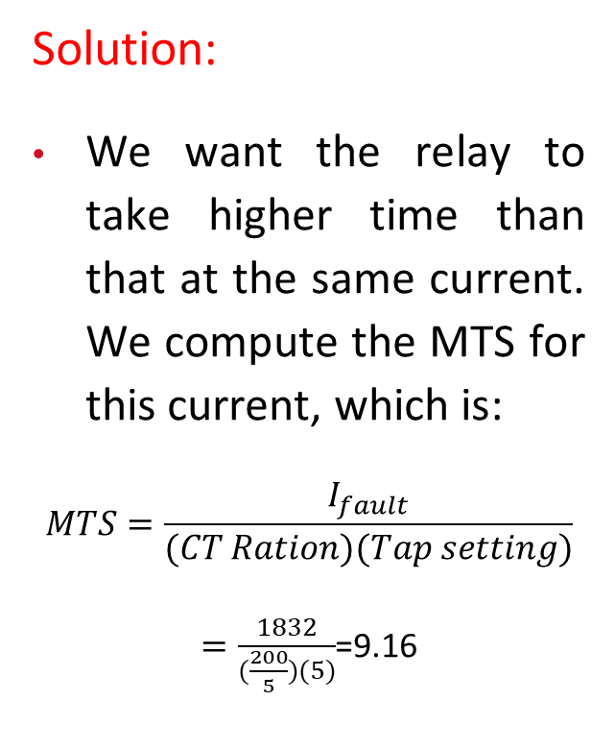
7.5 Circuit Breaker – Recloser Coordination
Solution:
We want the relay to take higher time than that at the same current. We compute the MTS for this current, which is:
$$MTS=\frac{I_{fault}}{(CT Ration)(Tap setting)}$$
$=\frac{1832}{(\frac{200}{5})(5)}$=9.16
Fig. Recloser and CO‐8 relay‐operating curves.

Slide 119
7.5 Circuit Breaker – Recloser Coordination
Solution:
CO‐8 relay with TD of 8 takes 0.3 seconds to operate, which provides sufficient margin between the operating time of the recloser and the circuit breaker.
Fig. Recloser and CO‐8 relay‐operating curves.

Slide 120
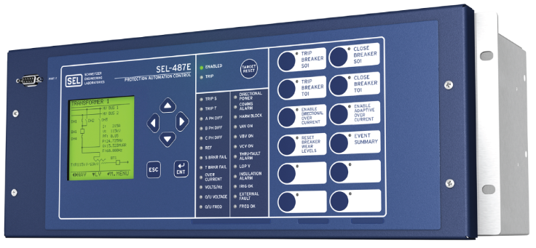
8. New Digital Sensing and Measuring Devices
8.1 Phasor Measurement Units (PMUs)
Synchrophasors are time-synchronized numbers that represent both the magnitude and phase angle of the sine waves found in ac electricity and are time synchronized for accuracy. They are measured by high-speed monitors called phasor measurement units (PMUs), shown in Figure, that are 100 times faster than supervisory control and data acquisition (SCADA).
Fig: Phasor Measurement Unit

Slide 121
8. New Digital Sensing and Measuring Devices
8.1 Phasor Measurement Units (PMUs)
PMU measurements record grid conditions with great accuracy and offer insight into grid stability or stress. Synchrophasor technology is used for real-time operations and off-line engineering analyses to improve grid reliability and efficiency and lower operating costs.

Slide 122
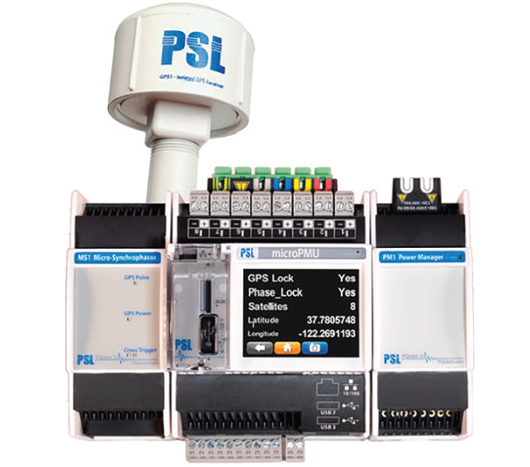
8. New Digital Sensing and Measuring Devices
8.2 Microphasor Measurement Units
PMUs installed in the power grid are currently positioned on the transmission system or in substations. A PMU creating real-time synchrophasor data from the consumer voltage level, called μPMUs, could provide new insights into modern power systems. An example of μPMUs is shown in Figure.
Fig: Micro-phasor measurement unit

Slide 123
8. New Digital Sensing and Measuring Devices
8.2 Microphasor Measurement Units
These units can be created more cheaply, an order of magnitude less, than current commercial PMUs. For this reason, many more PMUs could be deployed and provide a much higher resolution of the distribution grid.
There are many new applications for such a visible grid in postmortem event analysis and identification as well as near real-time monitoring. One such application is the fault location on a distribution system or microgrid with μPMUs, which provides accurate results.

Slide 124
8. New Digital Sensing and Measuring Devices
8.3 Optical Line Current Sensors
These are directly hung from an overhead line to obtain direct, digital current signals in each phase. These pole-top units use Faraday effect to get accurate and precise current measurements of line currents.
Thus, three sensors will be required for a three-phase system. These can be used for overhead lines from 120V up to 34.5 kV levels. These could also facilitate power quality measurements via a power quality (PQ) meter. Soon, it is likely to be adopted for underground systems.

Slide 125
8. New Digital Sensing and Measuring Devices
8.4 Optical Voltage Sensors
These utilize Pockels effect to derive voltage signals. Here also, three sensors will be required to seek digital and accurate voltage values from each of the three phases in overhead lines first and subsequently for underground distribution systems.

Slide 126
8. New Digital Sensing and Measuring Devices
8.5 Digital Pressure and Temperature Sensors
Though these are not common yet, a lot of research and development work is underway in developing these newer sensors by both utilities and equipment manufacturers. It is a matter of time before they become a reality.

Slide 127
8. New Digital Sensing and Measuring Devices
8.6 Evolving Sensors
Other developing state-of-the art-sensors such as extremely high-frequency point on wave, dynamic high-range sensors, optical PMU, and MagSense should be considered for adoption as time passes on. As nanotechnology matures, it is possible to envisage the development of newer sensors such as nanosensors for all sensing and measurement of electrical and nonelectrical quantities in the smart grid system.

Slide 128
8. New Digital Sensing and Measuring Devices
8.6 Evolving Sensors
One could even expect genetic sensors such as bacterial nanobionics sensors to penetrate the future distribution systems to improve the speed, precision, and accuracy of the above mentioned electrical variables.

Slide 129
9. Emerging Protection System Design and Coordination
Conventional protection approaches for distribution systems may become obsolete due to changes in the system.
Increased deployment of distributed energy resources (DER) in distribution systems has led to changes in the system topology.
Inverter-based resources (IBRs) pose challenges for fault detection and protection coordination.
Current-limiting features of inverters make it difficult to detect faults. Flow of current from distributed resources towards the fault further complicates protection.

Slide 130
9. Emerging Protection System Design and Coordination
Future protection schemes may rely on advanced methodologies and communication between system components.
Local and global coordination can be achieved using effective computer communication systems.
This approach is applicable to systems of any size, including grids and microgrids.
It can be used for both planning and automation of distribution systems.

Slide 131
Thank You!

